Slide 1
NBA Analysis
Group 6 aka. MoneyBalls
Patrick, Darren, Andrew, Hamish

Slide 2
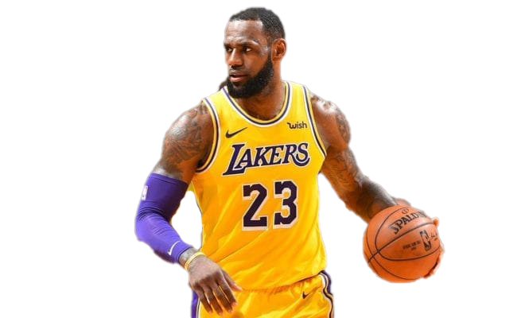
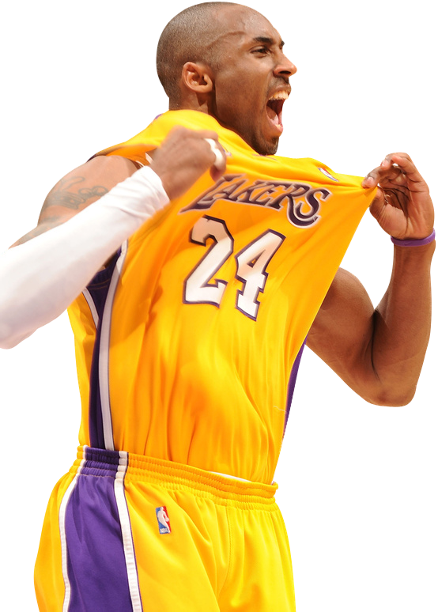

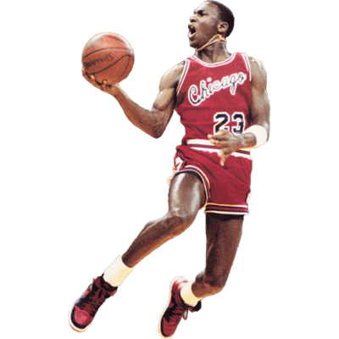
Motivation and Summary
LeBron James
What does box scores or traditional stats tells us?
How can we hypothesis statistically?
Who is the best shooter?
Can we use this analysis to make a case for the greatest of all time?
Hypotheses
The best shooter based solely on points scored will be Lebron James.
The best shooter based on the their field goal, three point and free throw percentages will be Kobe Bryant.
Total assists per player will be strongly correlated to number of turnovers per player.
Kobe Bryant
Michael Jordan

Slide 3
Aims
Data Aggregation
Data Acquisition (What we need and why we need it?)
We needed NBA players and teams statistics with the help of static player and team libraries and the endpoints within nba_api..
NBA.com stats are largely undocumented and difficult to use.
nba_api is an API package that allows one to access NBA.com APIs.
Data Cleaning
Relevant information about Jordan, Kobe, and LeBron.
Data Analysis
To answer our hypotheses we required shooting data from players as well as assist and turnover data from all the players in the 2019-20 season.
Data Visualisation (Plotly)

Slide 4
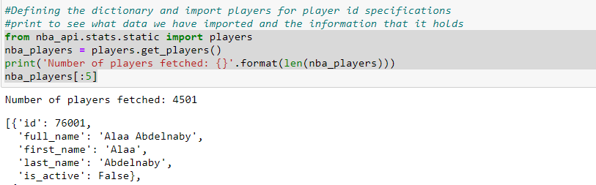
G.O.A.T Based on Total Points Scored
Finding Data (Part 1)

Slide 5
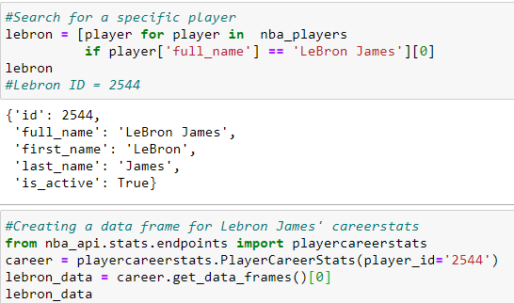
G.O.A.T Based on Total Points Scored
Finding Data (Part 2)

Slide 6
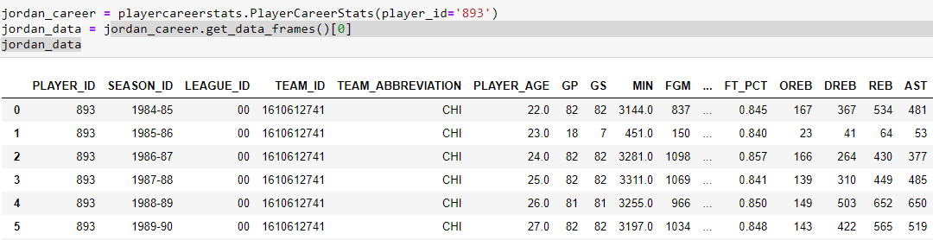
G.O.A.T Based on Total Points Scored
Finding Data (Part 3)

Slide 7
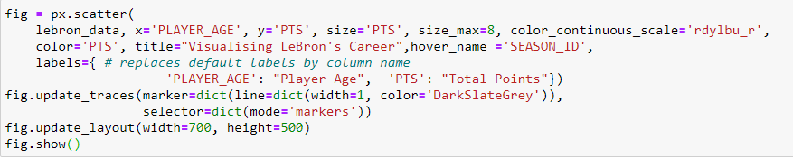
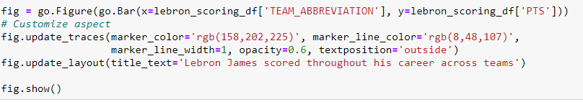
Plotting Findings
We used the plotly package to plot the total points scored by Kobe Bryant, Lebron James and Michael Jordan. Plotly is really useful as it makes some really nice looking charts and it is also quite interactive. Below is the code that we wrote to build two of the six charts that’ll be shown on the next slide.

Slide 14
Comparing G.O.A.T total points scored each season
We again used plotly to visualise the total points scored by each player over their careers.

Slide 15
Comparing total scored over each player’s career

Slide 16
Conclusion and Limitations
Ultimately Lebron James was the highest scorer throughout his career (which is still ongoing). Therefore, if one were to were to decide to anoint one of Lebron James, Kobe Bryant or Michael Jordan the G.O.A.T based solely on the total points scored metric, it would have to be Lebron.
Limitations
Outliers: Injury affected years hindered some player’s outputs.
Lebron James’ career is ongoing, so data could change.
There is more to a great basketball player than scoring. There is a reason why many basketball fans still argue about who is the G.O.A.T.

Slide 17
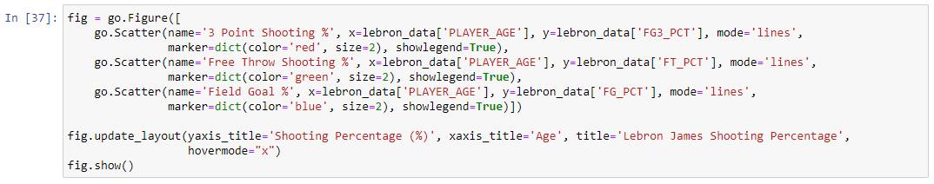
G.O.A.T Based on Shooting Accuracy
(LeBron James)
Notes:
In this block of code we again used the plotly module to plot the shooting percentages of each player’s three point shooting, free throw and field goals. The nifty benefit with plotly is that it allows us to interact with the graph. When you highlight over a certain point it tells us the age of the player and the shooting percentages for each category respective of the player’s age.

Slide 18
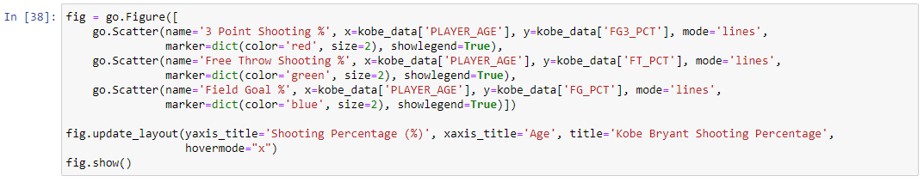
G.O.A.T Based on Shooting Accuracy
(Kobe Bryant)
Notes:
We then repeated the follow process for the other players to see if we could see a visual difference in their shooting accuracy.

Slide 19
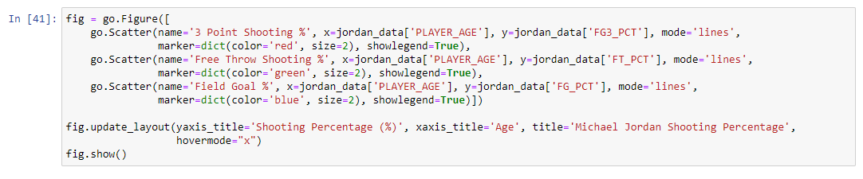
G.O.A.T Based on Shooting Accuracy
(Michael Jordan)
Notes:
From first glance we can see that Michael Jordan had the highest three point percentage (0.5/50%) however, from looking at graph alone it is still hard to determine who was the best shooter in terms of accuracy.

Slide 20
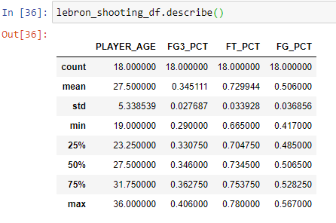
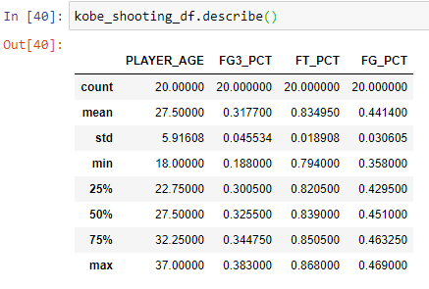
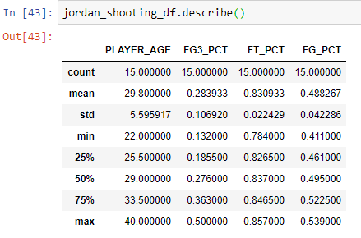
GOAT Based on Shooting Accuracy
(Comparison)
Notes:
So we then used a describe function on the players shooting percentages to give us a brief statistically summary. From this summary we can see the mean of the players shooting percentage per shooting category. We then summed all the shooting categories mean together to give us an overall average shooting percentage of each player to help us determine who was the best shooter in terms of accuracy. Lebron James (0.526), Kobe Bryant (0.530), Michael Jordan (0.533). Though the difference in their overall shooting average is small we can see that Michael Jordan had the highest overall shooting average. Furthermore if we were to award the best shooter per category at any given age we can see that through the max value that Michael Jordan had the best three point percentage, Kobe Bryant had the best free throw percentage and Lebron had the best field goal percentage.

Slide 21
Conclusions and Limitations
(Shooting Accuracy)
The overall average shooting percentage of each player: Lebron James (52.6%) | Kobe Bryant (53%) | Michael Jordan (53.3%)
If we were to award the best shooter per category: Three point = Michael Jordan | Free throw = Kobe Bryant | Field goal = Lebron James
Limitations:
As stated above the same limitations still apply for their shooting accuracy.
Notes:
Lebron James (0.526), Kobe Bryant (0.530), Michael Jordan (0.533). Though the difference in their overall shooting average is small we can see that Michael Jordan had the highest overall shooting average. Furthermore if we were to award the best shooter per category at any given age we can see that through the max value that Michael Jordan had the best three point percentage, Kobe Bryant had the best free throw percentage and Lebron had the best field goal percentage.

Slide 22
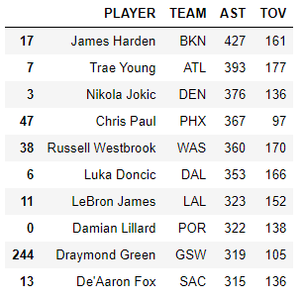
Assists Leaders vs Turnovers, Season 2019-20
We used the League Leaders endpoint from nba_api with the “Assist” parameter, which sorted all of the players from the 2019-20 season in descending order by total assists
Graphed Turnovers vs Assists using plotly
Used the in-built regression analysis within plotly to get r-value

Slide 23
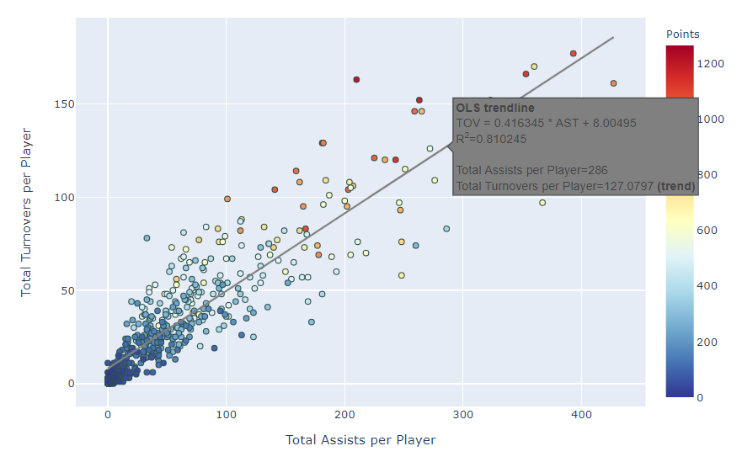
Total Assist vs Total Turnovers, Season 2019-20

Slide 24
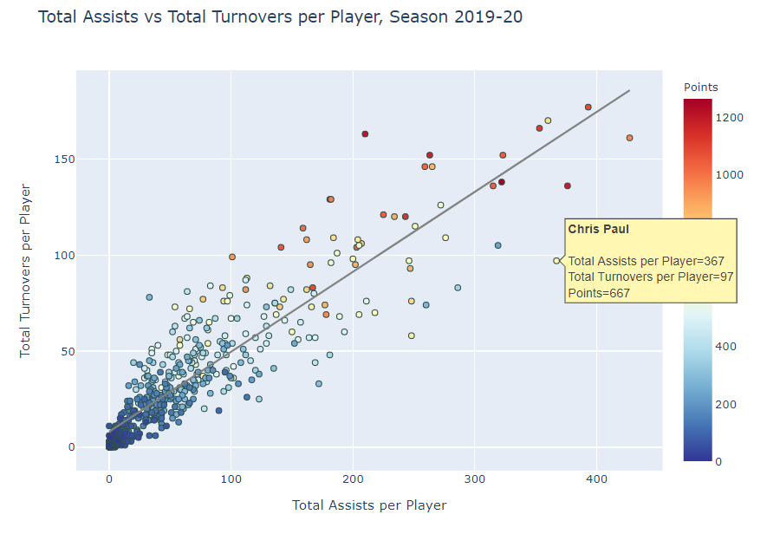

Slide 25
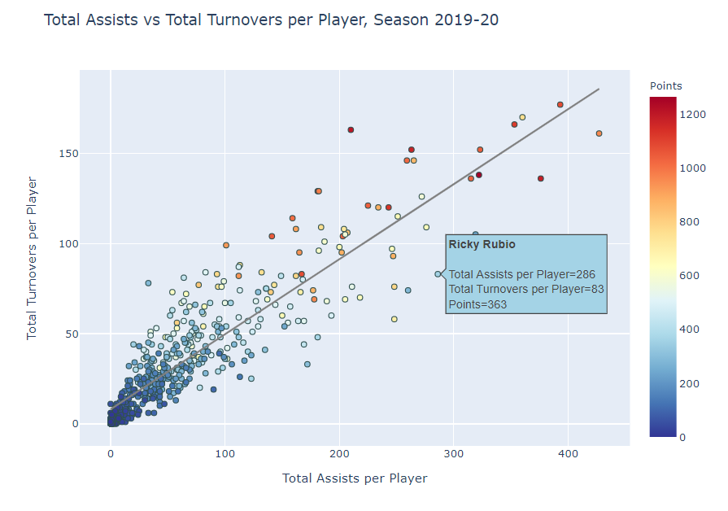

Slide 26
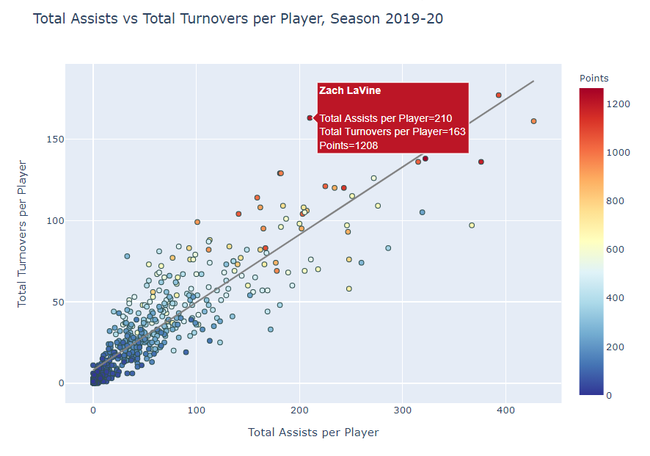

Slide 27
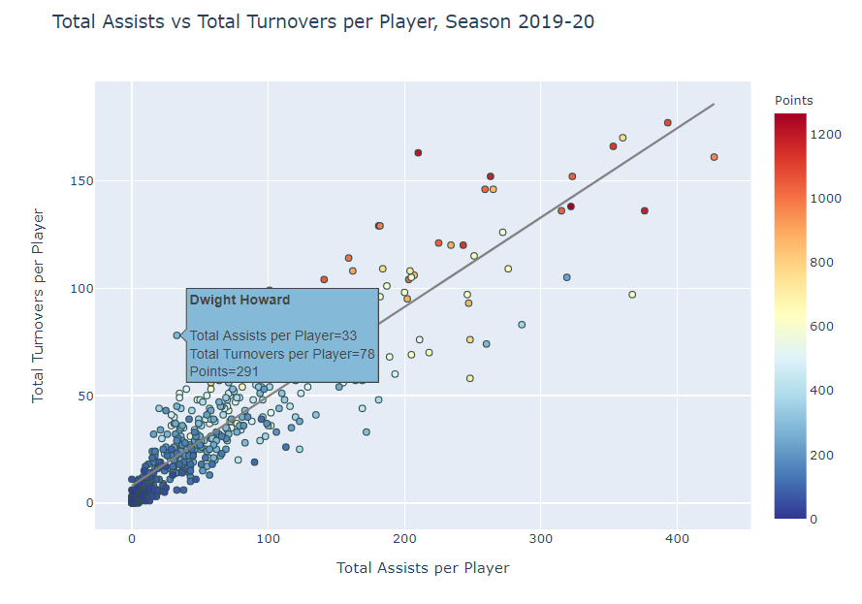

Slide 28

Discussion
What did we find?
LeBron has the highest total career points (ongoing)
Jordan was the most accurate of the 3
Jordan also had the highest mean points per season as well as the highest points in a single season
Can we make a definitive decision on who is the greatest shooter, let alone greatest of all time?
Assist and turnovers are quite strongly correlated, often the players with the most passes tend to have the ball for a longer periods of time and are expected to make plays, whether that’s through passing or otherwise, which risks a turnover.
Consider:
Injuries, season by season performance
Turnovers does not necessarily indicate bad performance, just that they use and carry the ball a lot

Slide 29
Post Mortem
Difficulties
Lack of endpoint syntax and guidance
LeBron is still an active player and therefore has time to improve his career stats
What Next?
Further analysis on other top scorers: Kareem, Karl Malone etc.
Generating a shot chart.
Looking at efficiency stats amongst players

Slide 30
Questions?

